Slide 1
.
Creating New Paths
to Social Change
in the Food System

Slide 2
.
I Three Sectors Logic
A New Way of
Seeing Forces at
Play in Society
Reclaim Common Sense

Slide 3
A Need-Based Economy
An economy satisfying stakeholder needs with least expenditure of:
Resources
Energy
Labor
Some Economic Indicators: basic human needs to be satisfied, that should be tracked in the economy:
Clean food and potable water
Housing
Access to clean air and sunshine
Clothing for work and leisure
Health care
Education
Transportation options
Access to basic communication technology …. (adapted from Gary Lamb Associative Economy)

Slide 4
Beyond Market and Government
Community Supported Agriculture
Premises
land as precondition of economic activity
not a commodity, cannot be produced
needs to be accessible to those who live there
Capitalistic Model | CSA | Socialist Model
Land as a commodity | Land as a resource for present and future generations | Land administered by state
Profit motive: Farming as business | Land as a living organism supporting land and farmer | Justice motive: farming as a place for equal opportunity

Slide 5
The Economic Power of CSAs
Unique levels of freshness and quality
Consumers and farmers bypass the middle-man. CSAs bypass the intermediary costs of transportation, packaging, processing, storage, marketing (75% of the average food price)
Little waste; ‘unaesthetic’ produce can be used. Surplus produce can be made available to those in need (e.g., food pantries).

Slide 6
The Economic Power of CSAs
Possibilities:
partnering with nearby farms to add variety of products; or with far-off farms for crops region cannot grow
CSAs membership base can be leveraged for better prices on bulk orders for products and even services.
CSAs can link with buying clubs: possible savings of up to 30-40% on kitchen, household supplies.
Trauger Groh: “community farm has no future without a network in New England of 100 or so similar farms that can support each other through trade and association.”

Slide 7
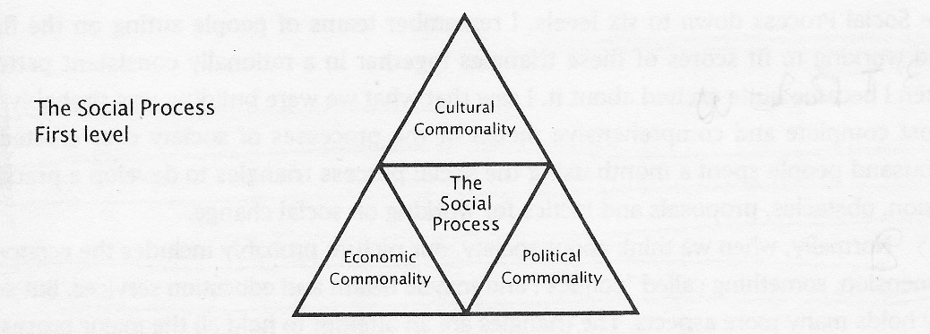
Social Process Triangles
(Institute of Cultural Affairs)

Slide 8
The Three Drives (ICA)
drive for survival, for resources, livelihood—the economic dimension of life—the “that-without-which” there can be no decision-making and no consciousness....
drive for order, for the organization of society through law-making, and law-enforcing bodies so that there is security and justice for all—the political dimension of society...
drive for meaning, that bleeds significance into both the economic and political dimensions of society. This is the cultural dimension.
(From Social Process Triangles, Maureen Jenkins, ICA)

Slide 9
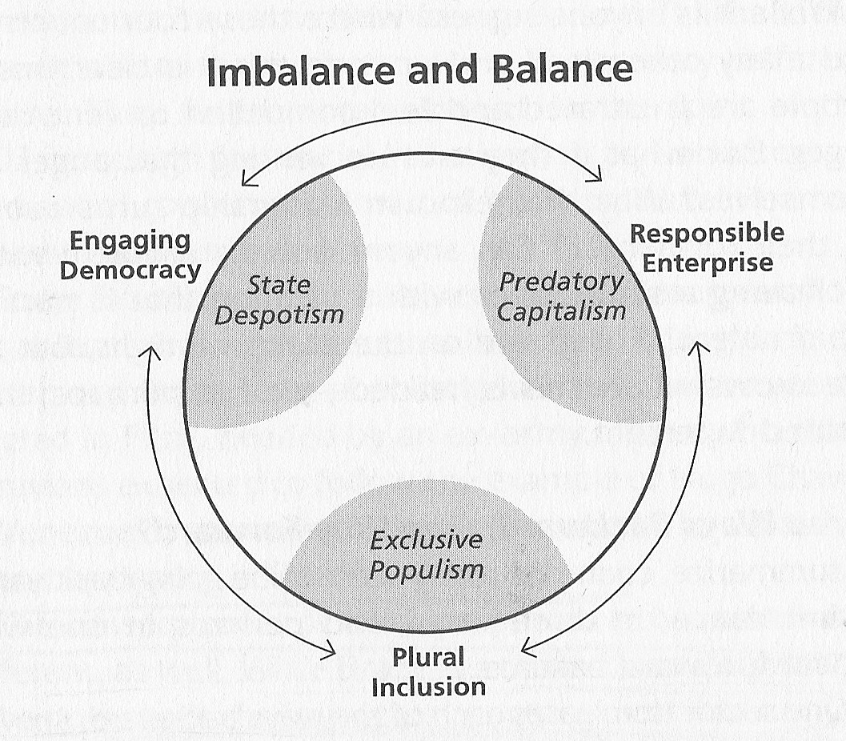
Rebalancing Society
(Henri Mintzberg)

Slide 10
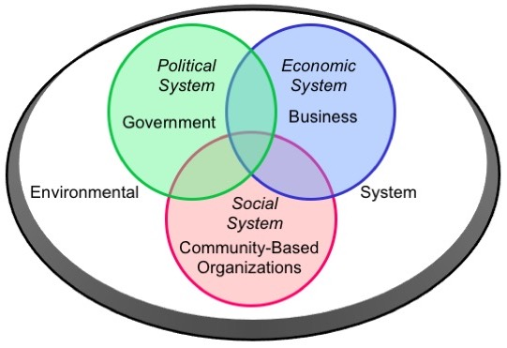
Three Sectors: Steve Waddell

Slide 11
Resources
Sharing the Harvest: A Citizen’s Guide to Community Supported Agriculture, Elizabeth Henderson and Robyn Van En
Farms of Tomorrow Revisited: Community Supported Farms⎯Farm Supported Communities, Trauger Groh and Steven McFadden
The Social Process Triangles, Jon C. Jenkins and Maureen R. Jenkins (unfortunately out of print)
Rebalancing Society: Radical Renewal Beyond Left, Right and Center, Henry Mintzberg
Societal Learning and Change: How Governments, Business and Civil Society are Creating Solutions to Complex Multi-Stakeholder Problems, Steve Waddell
Common Wealth: For a Free, Equal, Mutual and Sustainable Society, Martin Large
Shaping Globalization: Civil Society, Cultural Power and Threefolding, Nicanor Perlas

Slide 12
.
II Stakeholder Logic
A New Way of Relating:
Meeting Needs of all Parties
Be Real

Slide 13
Meet the Whole Person
Challenges of Being Blunt
  - Getting Emotional
  - Generating Conflict
  - Paralyzing Action
  Challenges of Being ‘Nice’
  Unable to tackle hot issues
  Danger of a culture of denial
  2 steps forward, 1 (or 2) backwards
  So How Can You Be Real?
  be honest; be empathic
  Meet the whole person in a safe space

Slide 14
US Organic Grain Collaboration
& Sustainable Food Lab
Project Goals: address key challenges in expanding the supply of organic grain in the US by:
improving profitability, and market access
improving resiliency
Works with farmers and other stakeholders in Aroostook County, Maine and in the Northern Great Plains.
Project Partners: Annie’s Organic, Ardent Mills, Clif Bar, General Mills, King Arthur flour, Pipeline foods, Stonyfield Organics, Organic Valley, Sustainable Food Lab.
Source: Elizabeth Reaves, Carol Healy, Jedediah L Beach, US Organic grain: How to Keep It Growing, February 2019.

Slide 15
U.S. Organic Grain Collaboration 2018 report
Challenges of Entering & Staying in Organic Grain Production
# 1 High Cost of Transition and Market Guarantee at End of transition period
# 2 Soil Fertility and Weed Suppression
# 3 Suboptimal Farm Management Resources
Industry Solutions Needed
# 1:Provide long-term forward contracts
# 2: Coordinate and develop markets for non-cash crops that increase soil fertility and suppress weeds
# 3 New models of knowledge delivery: support farmers to learn and innovate
together around solutions and research adapted for regional conditions.
Source: Elizabeth Reaves, Carol Healy, Jedediah L Beach, US Organic grain: How to Keep It Growing, February 2019.

Slide 16
Sustainable Food Lab
integrates Theory U with approaches from the Society for Organizational Learning
Stimulates forming of tri-sector partnerships. Examples of participants:
nonprofits: Oxfam, the Nature Conservancy, the World Wildlife Fund, the Rainforest Alliance, and the Kellogg Foundation
governmental organizations from Brazil and the Netherlands government agencies, the European Commission
corporations and businesses Unilever, General Mills, the International Finance Corporation, Green Mountain Coffee, Organic Valley Cooperative, farmer coops in Latin America, Rabobank, Sysco, and Costco

Slide 17
Sustainable Food Lab
Keys to success:
Pledging forty days of time over two years
look at global food system with a systemic approach
In depth interviews
Learning journeys to places of great potential
Commitment to generative dialogue
collaboratively envisioning how to change the system in a way that works for all

Slide 18
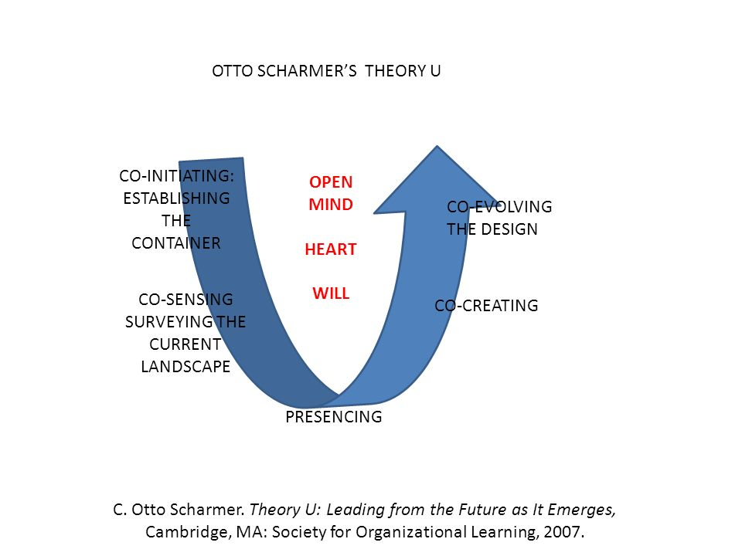
U Pattern

Slide 19
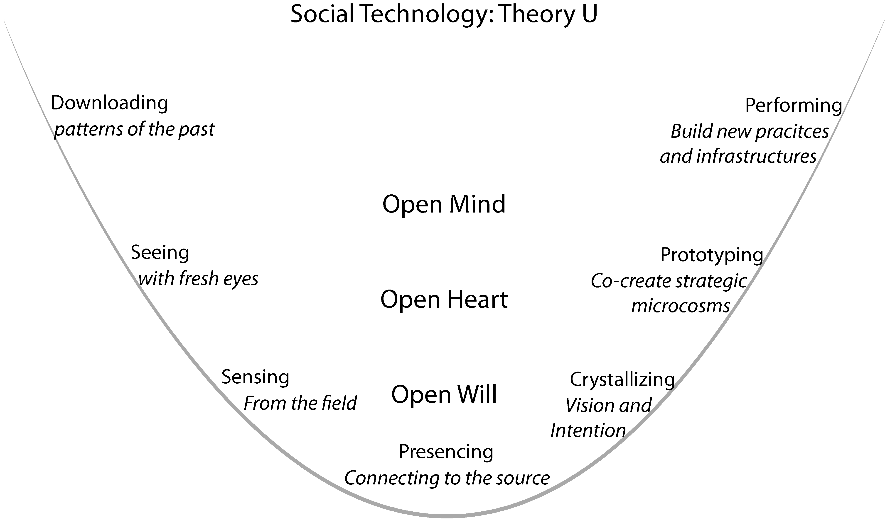
Theory U: Working with Organizations

Slide 20
Presencing
“When I am part of a social field that crosses the threshold at the bottom of the U, it feels as if I am participating in the birth of a new world. It’s a profound, quieting experience in that I feel as if I’ve been touched by eternal beauty. There is a deep opening of my higher Self” Betty Sue Flowers
“…moving through the bottom of the U is becoming aware of the incredible beauty of life itself, of becoming re-enchanted with the world … When the sort of commitment you are talking about happens, you feel as if you’re fulfilling your destiny, but you also feel as if you’re freer than you’ve ever been in your life. It’s a huge paradox.” Joseph Jaworski
“For me, the core of presencing is waking up together – waking up to who we really are by linking with and acting from our highest future Self – and by using the Self as a vehicle for bringing forth new worlds”
Otto Scharmer

Slide 21
Resources
Theory U executive summary: Leading from the Future as it Emerges https://www.presencing.org/assets/images/theory-u/Theory_U_2pageOverview.pdf
How to Escape Your Organization’s Echo Chamber https://consciouscompanymedia.com/the-new-economy/how-to-escape-your-organizations-echo-chamber/
Leading the Relational Inversion: From Ego to Eco, C. Otto Scharmer and Katrin Kaufer http://www.ottoscharmer.com/sites/default/files/13.2_Scharmer_and_Kaufer.pdf (scroll down to p.4)
Peggy Holman and alia: The Change Handbook: Group Methods for Shaping the Future, a Compendium of Participatory Change Processes.
Dynamic Governance (aka Sociocracy): http://sociocracyforall.org/sociocracy/#4minvideo and http://sociocracyforall.org/resources/#articles

Slide 22
.
III Multi Scale Logic
A New Way of
Working at All Scales
Be Daring

Slide 23
Live at Ease with Paradox and Change
Reconcile:
- Collaboration
- Entrepreneurial spirit
- Coordination
- Self-organization
- Order
- Chaos

Slide 24
Socially Generative Networks
Systems Thinking Approach
Reliance on Emergence: “an unplanned and uncontrollable process in which properties such as capacity emerge from the complex interactions among all actors in the system and produce characteristics not found in any of the elements of the system.”
Encouraging self-organizing
Multi-scale level of activity
Stewardship
  Sense and respond approach to planning
  Encourage leaderfulness throughout the network
Inclusion of more than one sector

Slide 25
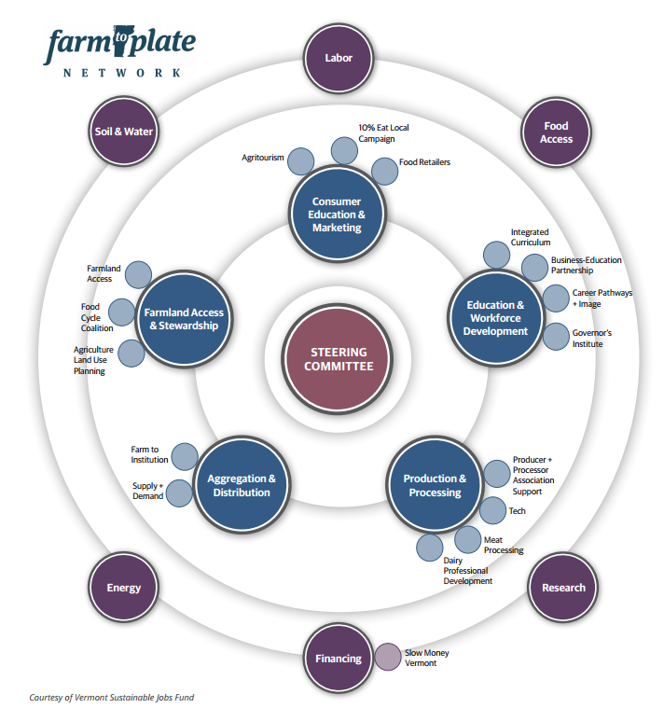
VT Farm to Plate (F2P)

Slide 26
F2P Results
From 2009 to 2014 the work of the Farm to Plate network:
added some 2,162 jobs and 199 establishments
decreased food insecurity in the state for the first time since the Great Recession
expanded number of food hubs/incubators in the state
thanks to the work of F2P’s Meat Processing Task Force, launched in 2011, opened five new slaughter houses and two new processing-only facilities

Slide 27
F2P Results
provided financing and access to solar, wind energy, methane digestors, biomass heaters to farms in VT
expanded pallet of loans and financing options to new food related initiatives
After 5 years, members report:
75%: network helps advance their goals
75% are building new relationships
80% are strengthening existing relationships

Slide 28
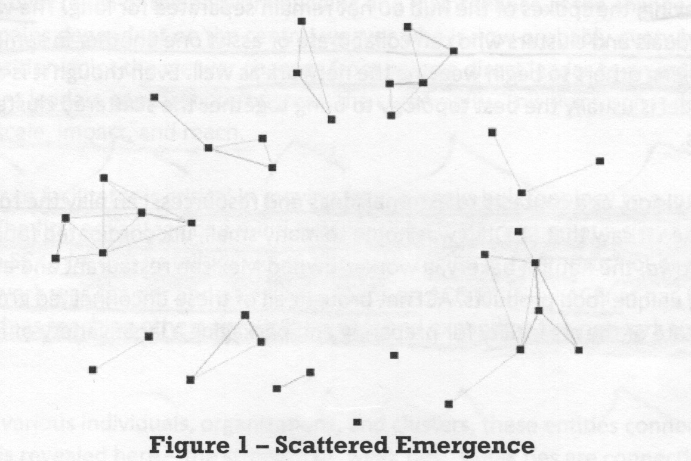
Network: Scattered Emergence

Slide 29
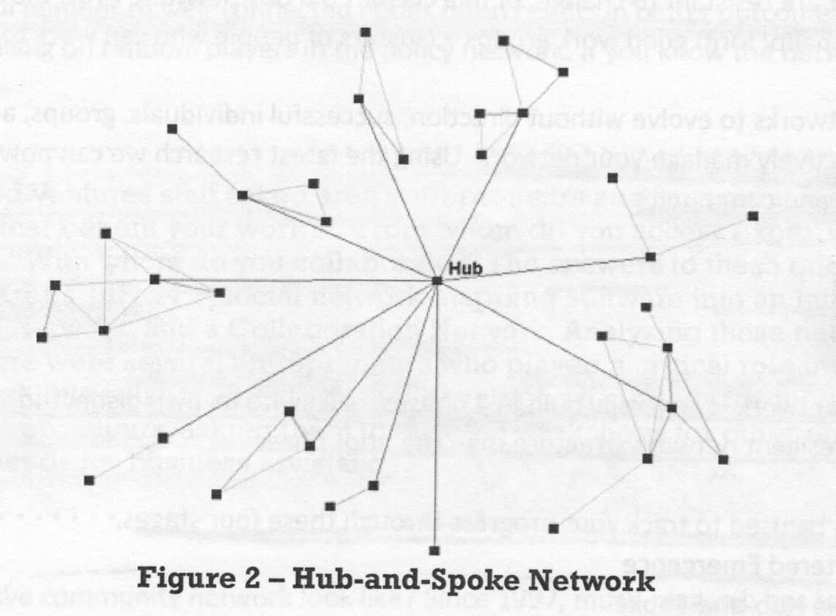
Hub and Spoke Network

Slide 30
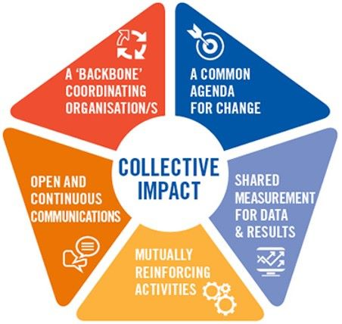
Collective Impact
Connection – Alignment - Production

Slide 31
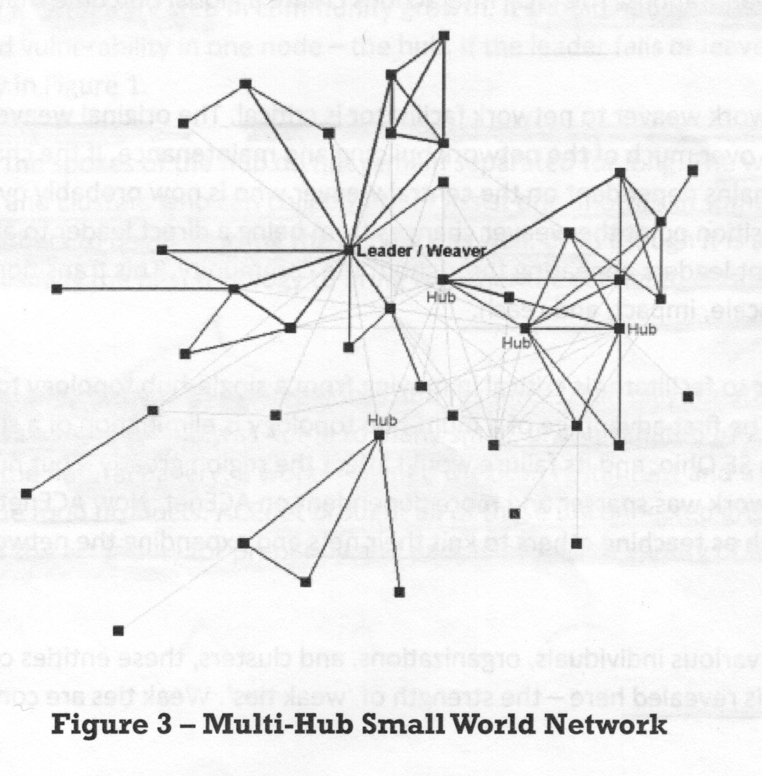
Multi-Hub Small World Network

Slide 32
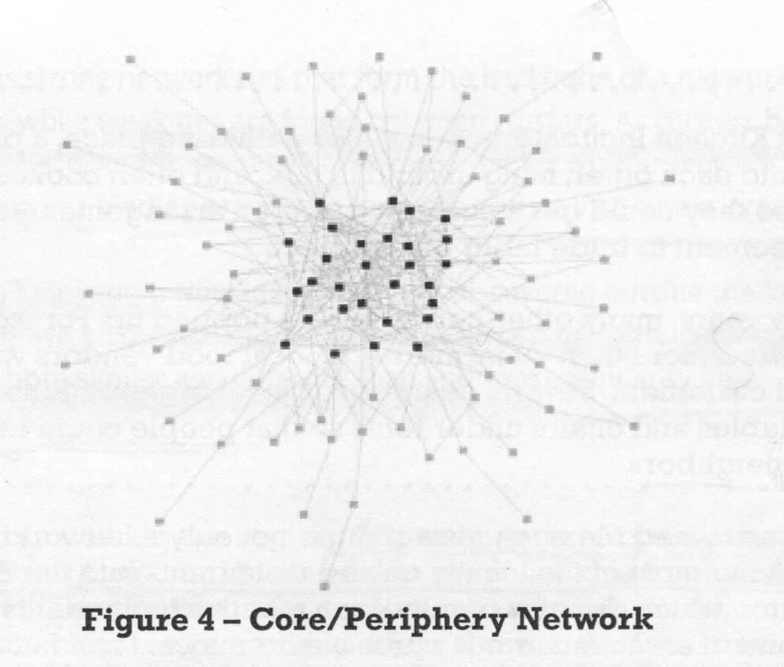
Core-Periphery Network

Slide 33
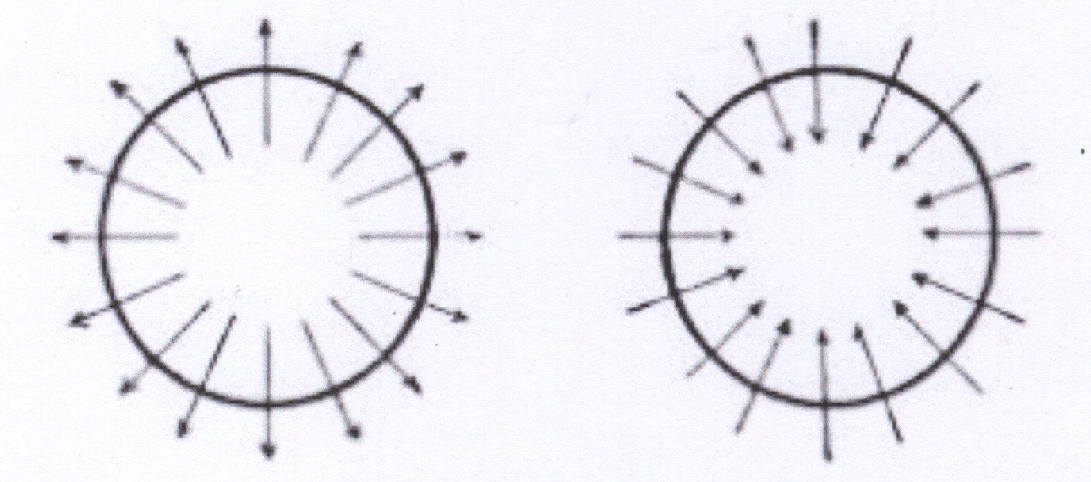
Stewardship Attitude

Slide 34
STEWARDSHIP Qualities
Catalyzes a culture of vigorous collaboration: deep listener appreciates diverse perspectives; both/and thinker; shows gratitude, encourages mutual appreciation
Shares power and generates momentum: embraces ambiguity, encourages experiment and innovations; trusts conflict’s generative potential ; encourages leaderfulness
Stays true to the long term vision: helps others see the system; continuously adapts with the long-term vision

Slide 35
Resources
June Holley: Network Weaving Handbook (a how-to guide): https://networkweaver.com/network-weaving-handbook/
Peter Plastrik et alia: Connecting to Change the World: Harnessing the Power of Networks for Social Impact
Steve Waddell: Global Action Networks: Creating Our Future Together
June Holley’s blog at https://networkweaver.com/category/blog/
Transformer: How to Build a Network to Change a System: a Case Study of the RE-AMP Energy Network: https://www.reamp.org/wp-content/uploads/2014/01/Monitor-Institute-RE-AMP-Case-Study.pdf

